Slide 1
Serverless Shiny
George Stagg, Phil Bowsher
Posit, PBC

Slide 2

webR: R for WebAssembly
WEBR
The webR project is a version of the R interpreter built for WebAssembly.
Execute R code directly in a web browser, without any supporting R server.

Slide 3
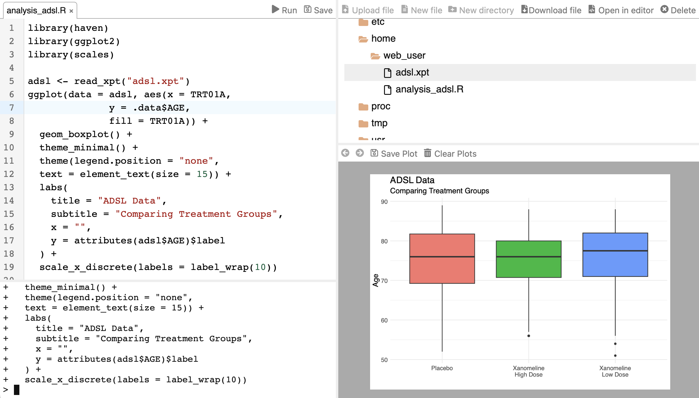
https://webr.r-wasm.org
WEBR

Slide 4

How it works: WebAssembly (2017)
WEBR
A portable binary code format
Enables high-performance applications on web pages
Near-native execution speed
Supported by most modern browsers
Containerization
Sandboxing
Interactivity
Reproducibility
Software portability
Universal binaries

Slide 5
What do I mean by server?
R SERVER
A workstation, under a desk, running R
Shiny Server Open Source
Posit Cloud/Workbench
shinyapps.io/Posit Connect Cloud
Posit Connect enterprise deployment
AWS/Google/Azure cloud hosting

Slide 6
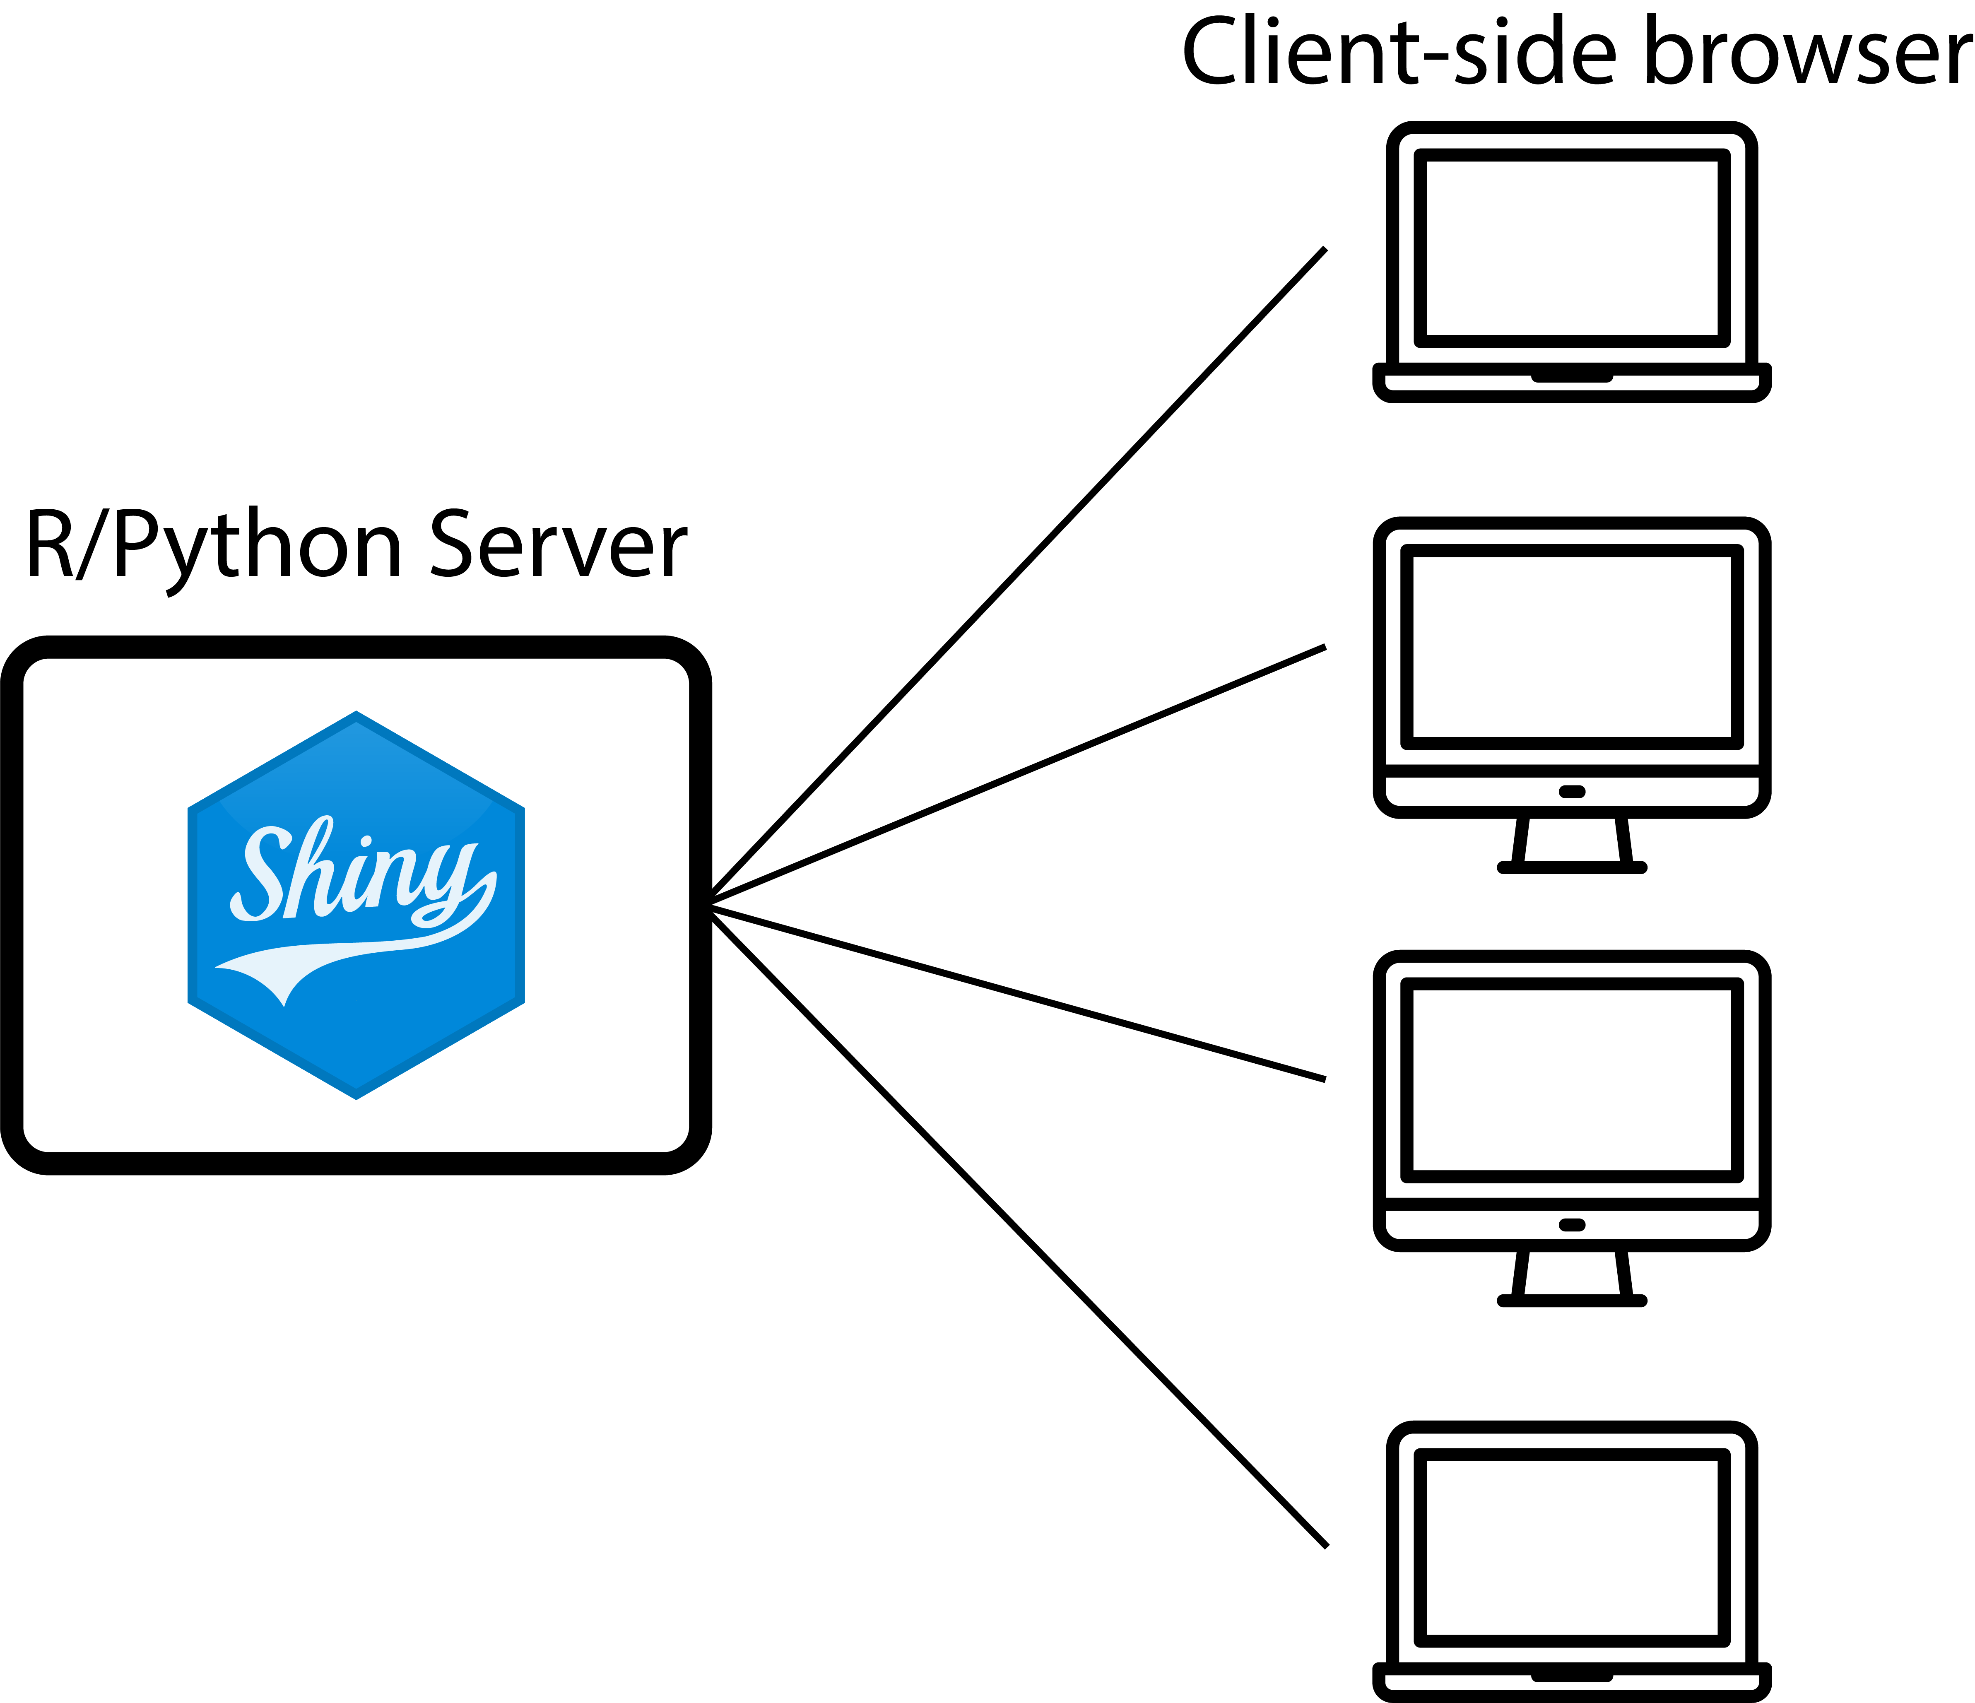
Traditional Shiny Server
R SERVER

Slide 7
Distribute R source code?
R SERVER
Transfer source and data to some other machine.
Prepare environment with R & RStudio.
Run the app with a local Shiny server.
How do we ensure the results and conclusions are the same on every machine?

Slide 8
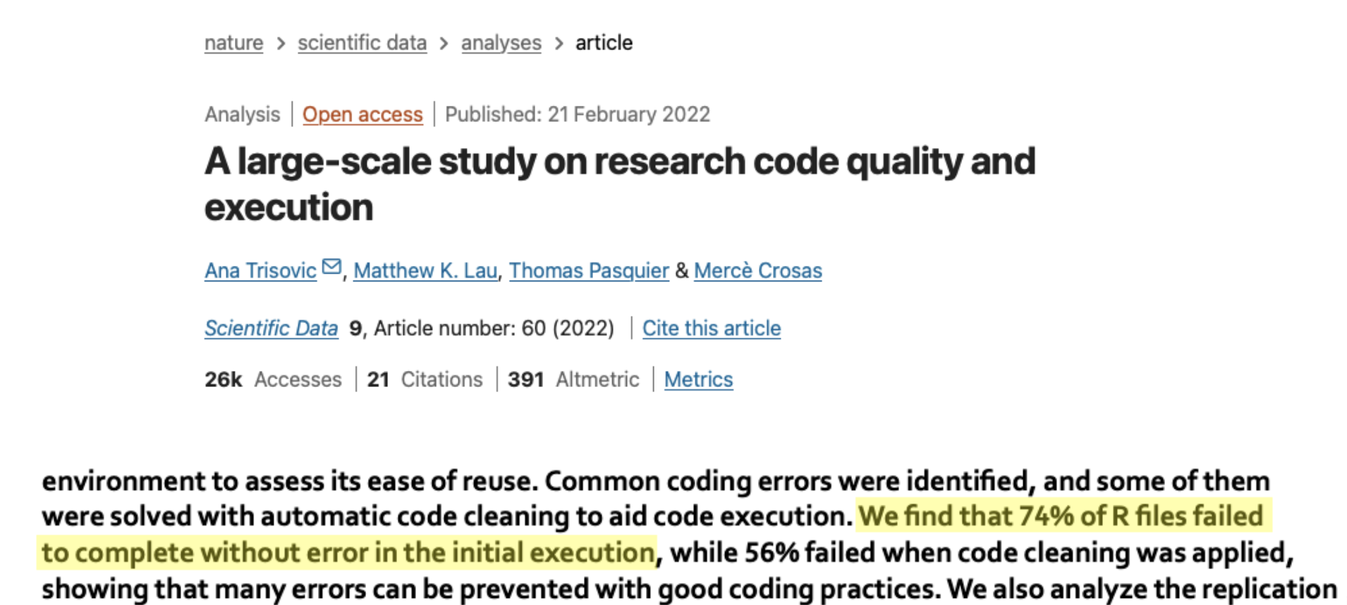
REPRODUCIBILITY IN DATA SCIENCE

Slide 9
Computing environments
REPRODUCIBILITY IN DATA SCIENCE
Many different computational environments exist, all can affect an analysis.
Language and package management
Versions of interpreter software:
R 3.6.3, 4.1.3, 4.4.1
Versions of packages
System and library management
System libraries: GSL, BLAS/LAPACK
Operating system: Windows, macOS, Linux
Tools: rig, pak, renv, Virtual Machines, Docker, Nix/Rix
Very slow to reproduce environment in full, especially without caching!
Difficult to use, very steep learning curve.

Slide 10
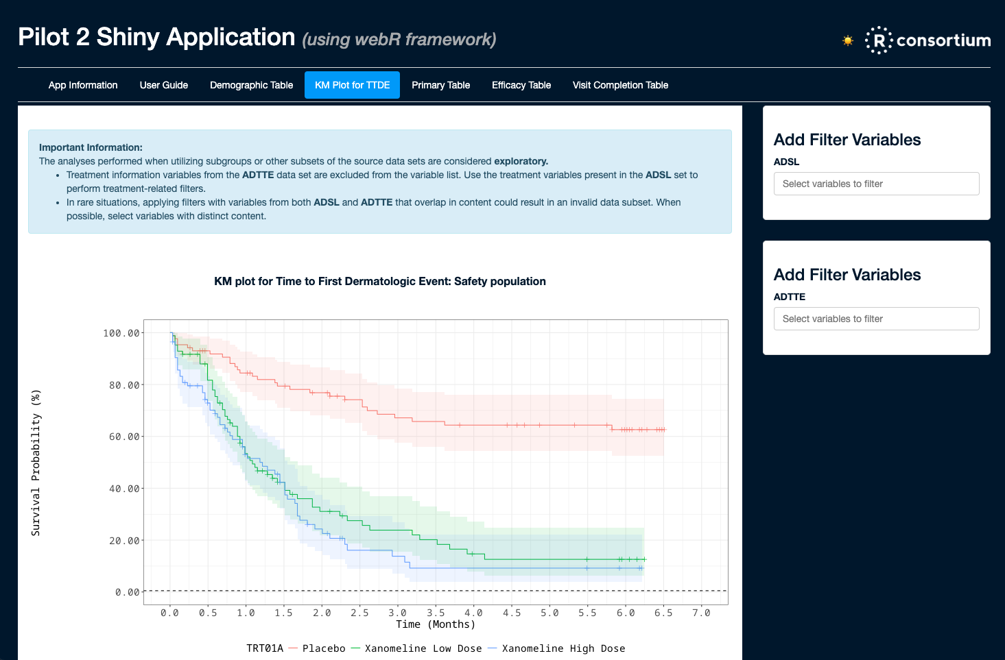
R Consortium Submission Working Group https://rconsortium.github.io/submissions-wg/
SHINYLIVE
Create clinical trial submission deliverables with open-source software
Consists of Industry and Regulatory members
Pilot 3: Successful Shiny app submission to FDA reviewers
Now investigating containers and WebAssembly for Shiny app submission.
🔗 Testing Containers and WebAssembly in Submissions to the FDA - pharmaverse.github.io
🔗 Shiny Based Clinical Submissions - Eric Nantz posit::conf(2024)

Slide 11
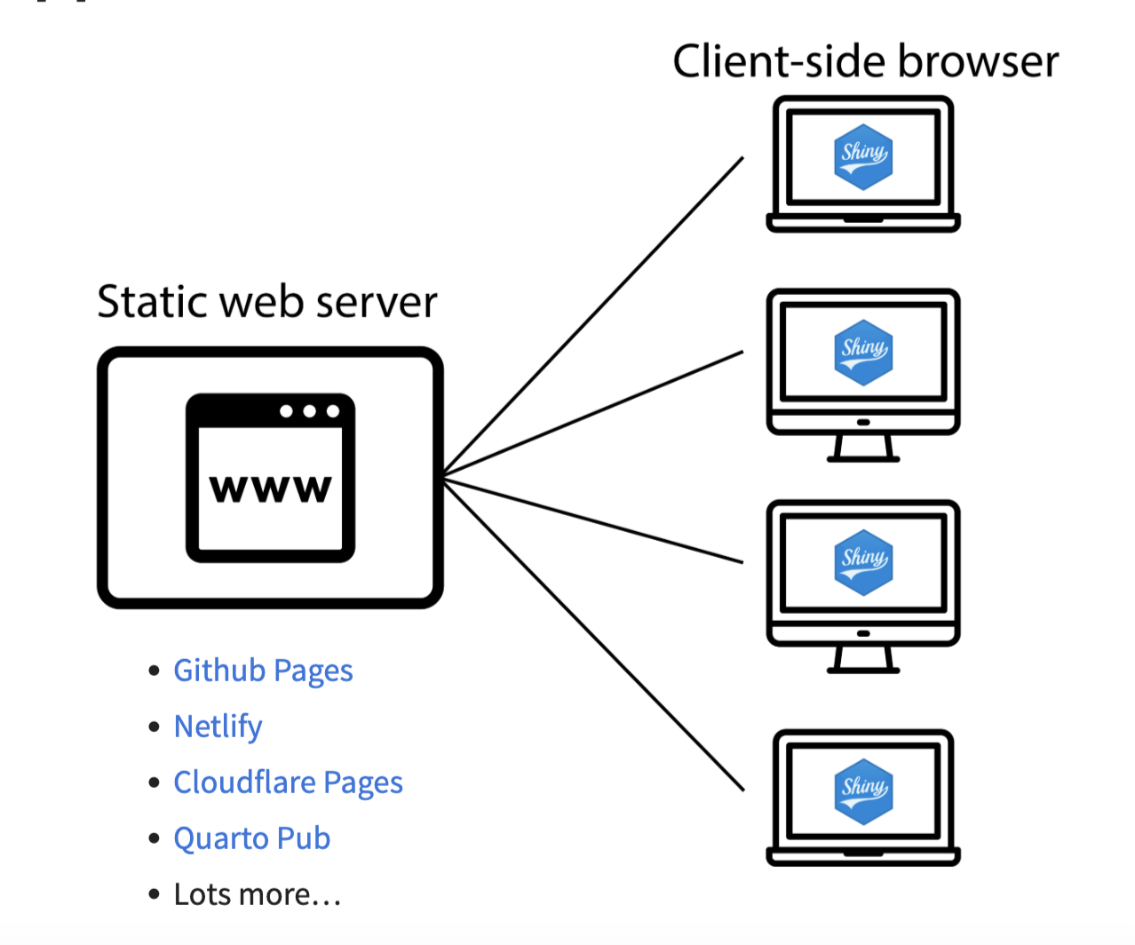
Shinylive App
SHINYLIVE

Slide 12
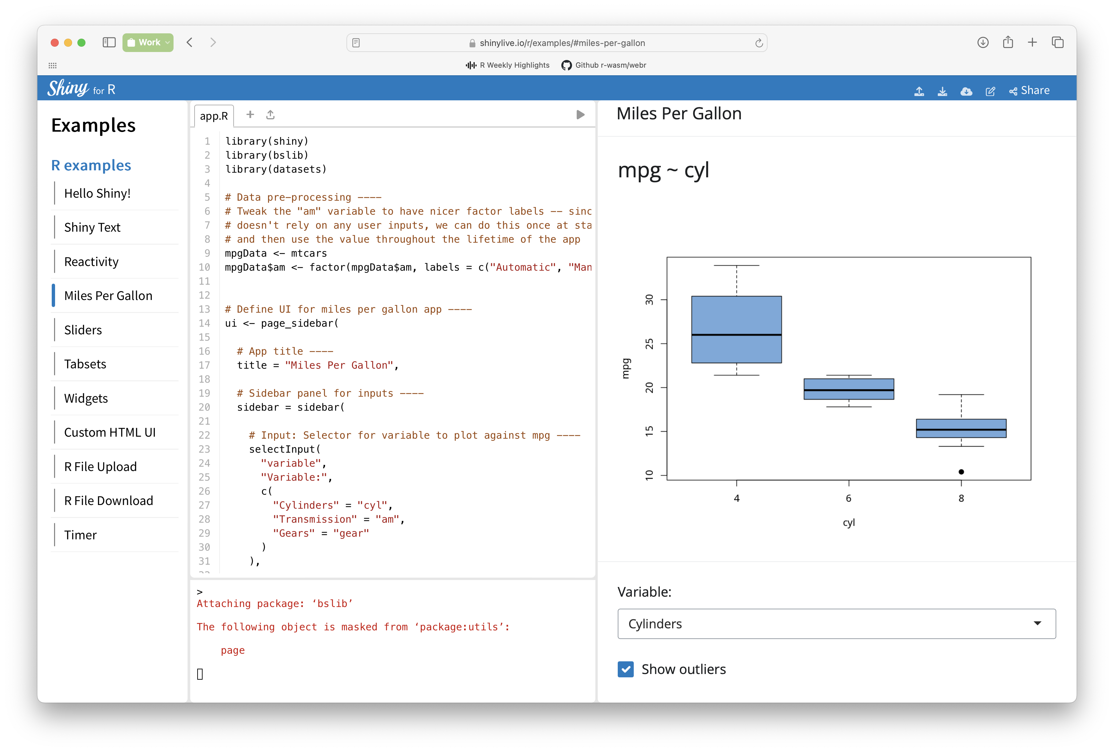
Shinylive Website: https://shinylive.io/r/
SHINYLIVE

Slide 13
Convert a Shiny app to Shinylive
SHINYLIVE
Install the Shinylive R package:
> install.packages("shinylive")
Convert the app:
> shinylive::export("myapp", "site")
Binary bundle ready to transfer to another machine or host online
> httpuv::runStaticServer("site")

Slide 14
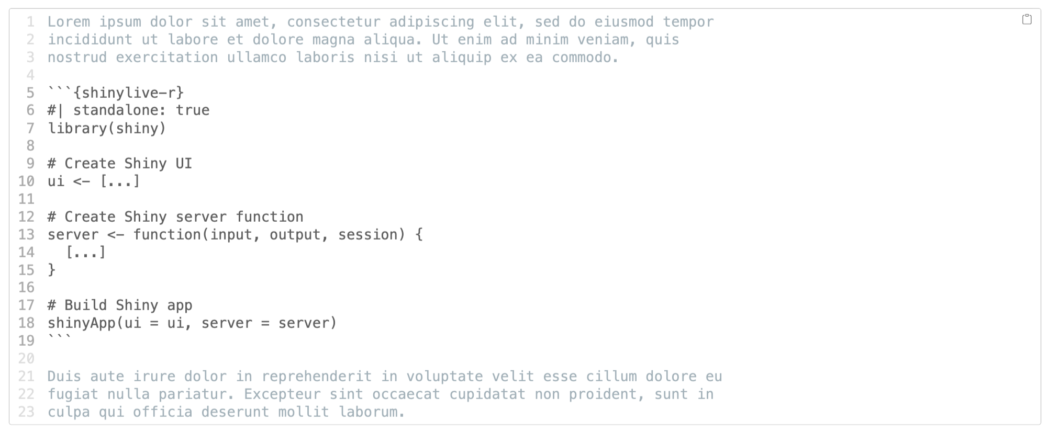
Shinylive in Quarto
SHINYLIVE

Slide 15
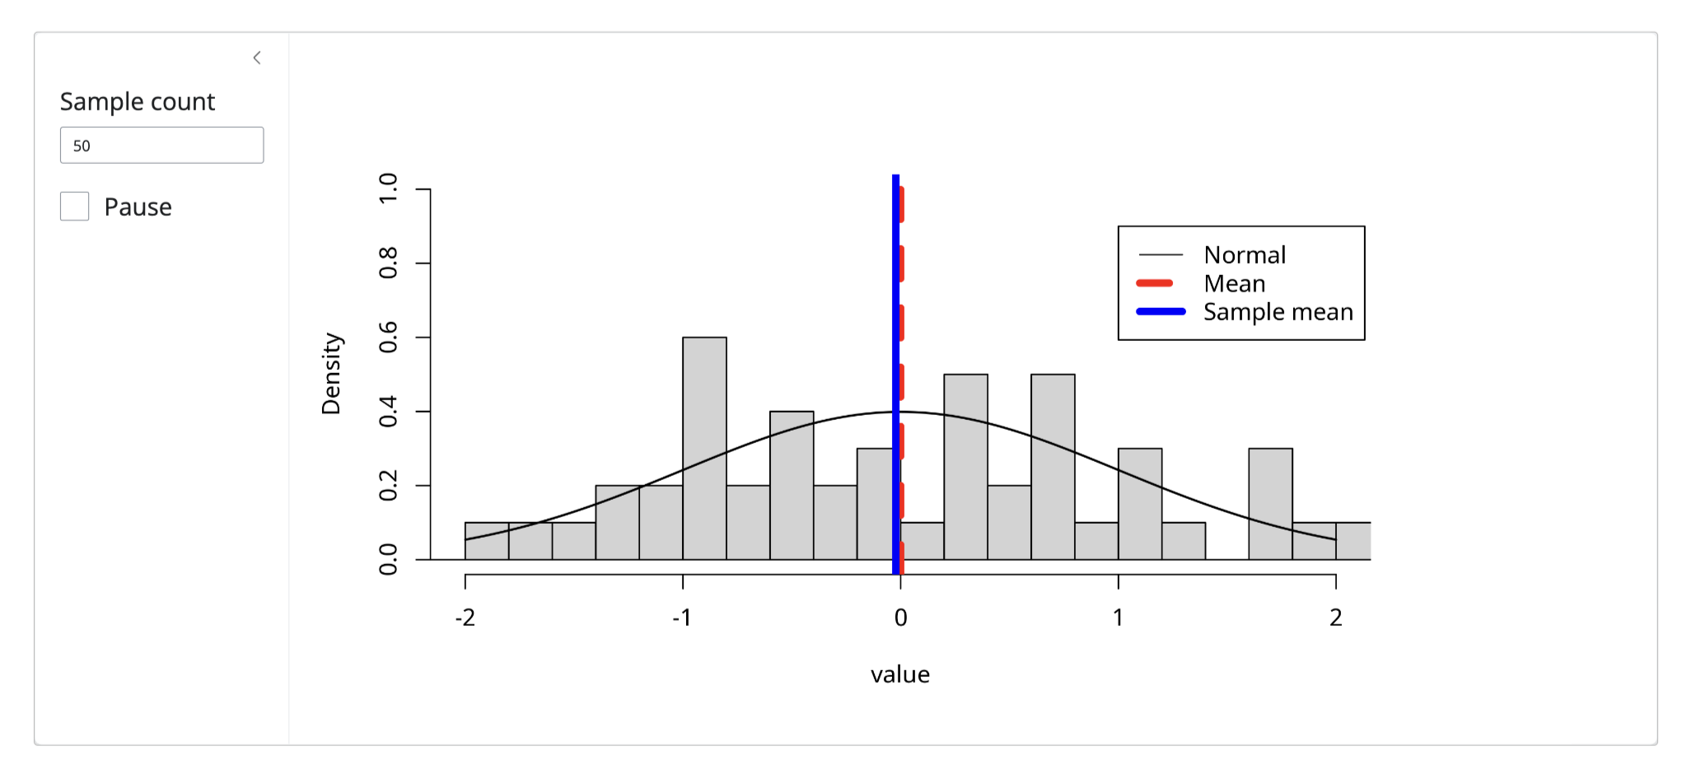
Shinylive in Quarto
SHINYLIVE

Slide 16

WebAssembly R packages
WEBASSEMBLY R PACKAGES
Binary R packages for WebAssembly are available from CRAN-like repositories
Over 65% of CRAN packages available for webR
https://repo.r-wasm.org
R-Universe provides bioconductor, custom R packages
https://r-universe.dev
Recent improvements:
Improved bundling
No external dependencies, long-term reproducibility

Slide 17
Future work and current issues
Not all R packages work under WebAssembly.
No {curl} package currently
Requires a web server, even for local Shinylive applications.
There will always be good reasons to use a traditional Shiny deployment.
Browser security restrictions:
Limited networking
No raw socket access, no external database access,.
There are no secrets with a Shinylive app!
Anything in the app source can be viewed.

Slide 18
Thank you.

